Slide 1
Journey PPT
Week 5

Slide 2
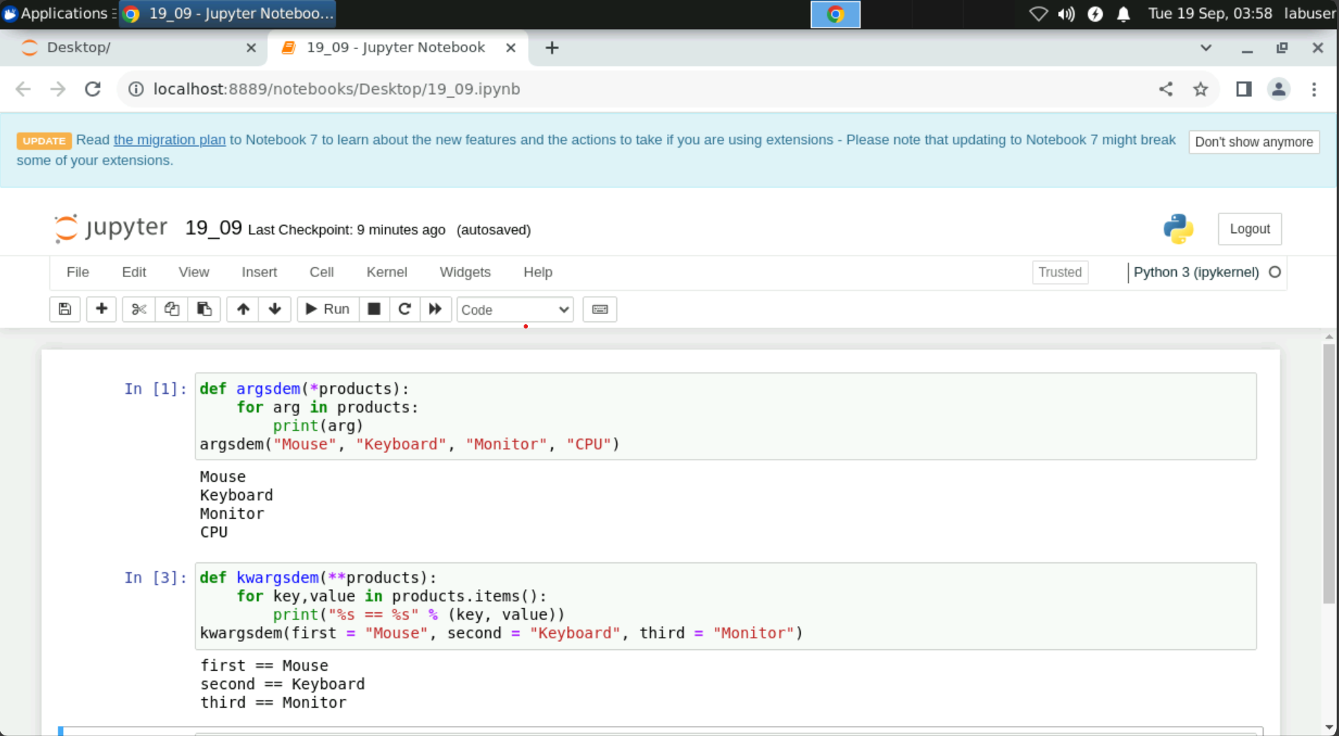
19-09-2023

Slide 3
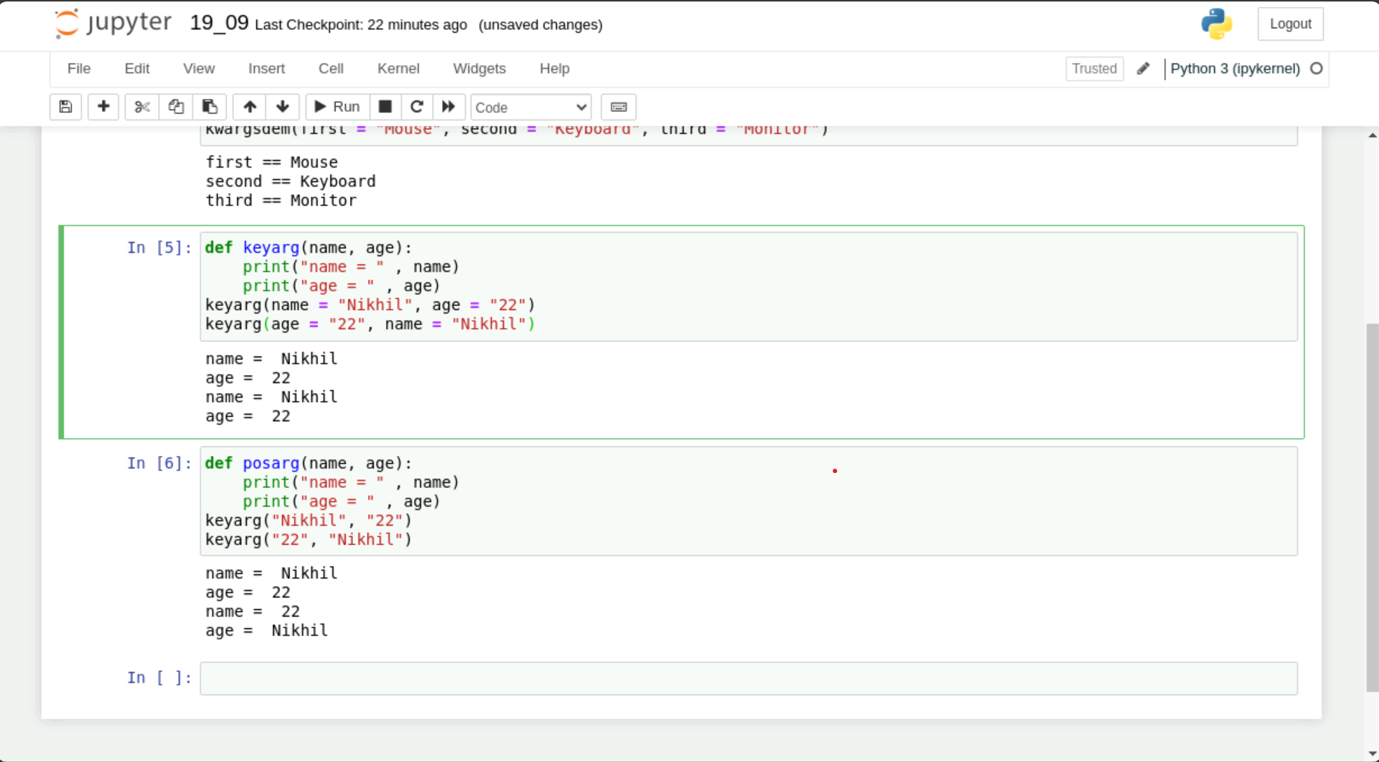

Slide 4
21-09-2023
PySpark
Architecture contains driver, cluster manager and compute nodes
Works on lazy evaluation
One job is created per action by driver node
Types of transformation
Narrow
Wide

Slide 5
21-09-2023
RDD
Resilient Distributed Dataset
Caching

